Slide 1
Chapter 5: Database Security
Week 8

Slide 2
Chapter 5
Self reading from section 5.1 to 5.3

Slide 3
Database systems
Structured collection of data stored for use by one or more applications
Contains the relationships between data items and groups of data items
Can sometimes contain sensitive data that needs to be secured
Query language: Provides a uniform interface to the database

Slide 4
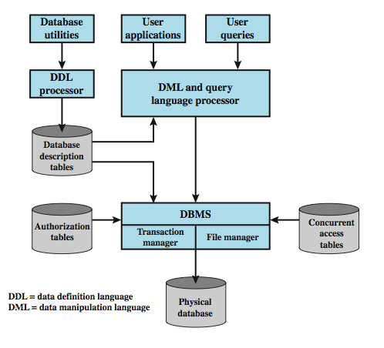
Database Security

Slide 5
Relational Databases
Constructed from tables of data
  each column holds a particular type of data
  each row contains a specific value these
  ideally has one column where all values are unique, forming an identifier/key for that row
Have multiple tables linked by identifiers
Sse a query language to access data items meeting specified criteria

Slide 6
Relational databases
Table of data consisting of rows and columns
  Each column holds a particular type of data
  Each row contains a specific value for each column
  Ideally has one column where all values are unique, forming an identifier/key for that row
Enables the creation of multiple tables linked together by a unique identifier that is present in all tables
Use a relational query language to access the database
  Allows the user to request data that fit a given set of criteria

Slide 7
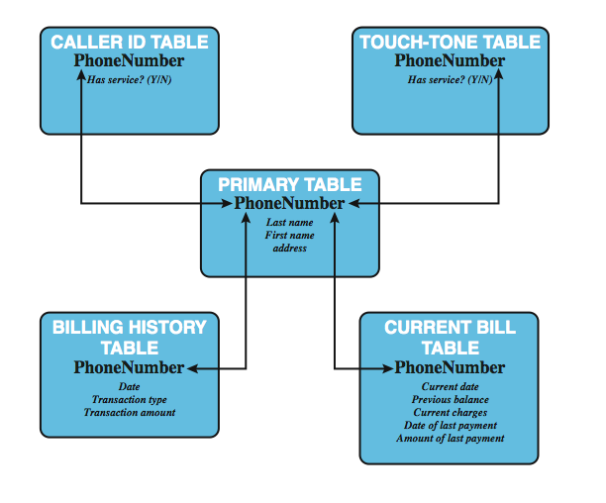
A relational database example

Slide 8
Relational database terms
Relation/table/file
Tuple/row/record
Attribute/column/field
Primary key: uniquely identifies a row
Foreign key: links one table to attributes in another
View/virtual table: Result of a query that returns selected rows and columns from one or more tables

Slide 9
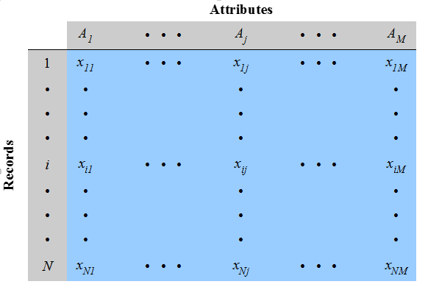
Abstract view of a relation

Slide 10
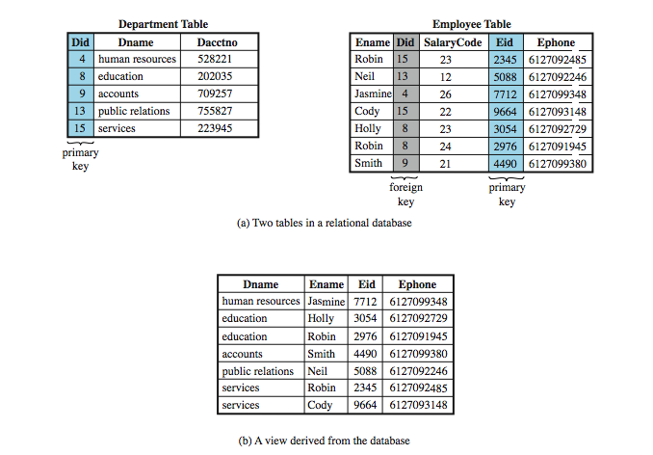
Relational Database Elements

Slide 11
Structured Query Language
Structure Query Language (SQL)
  originally developed by IBM in the mid-1970s
  standardized language to define, manipulate, and query data in a relational database
  several similar versions of ANSI/ISO standard
CREATE TABLE department (
Did INTEGER PRIMARY KEY,
Dname CHAR (30),
Dacctno CHAR (6) )
CREATE TABLE employee (
Ename CHAR (30),
Did INTEGER,
SalaryCode INTEGER,
Eid INTEGER PRIMARY KEY,
Ephone CHAR (10),
FOREIGN KEY (Did) REFERENCES department (Did) )
CREATE VIEW newtable (Dname, Ename, Eid, Ephone)
AS SELECT D.Dname E.Ename, E.Eid, E.Ephone
FROM Department D Employee E
WHERE E.Did = D.Did

Slide 12
SQL injection attacks
One of the most prevalent and dangerous network-based security threats
Sends malicious SQL commands to the database server
Depending on the environment SQL injection can also be exploited to:
  Modify or delete data
  Execute arbitrary operating system commands
  Launch denial-of-service (DoS) attacks

Slide 13
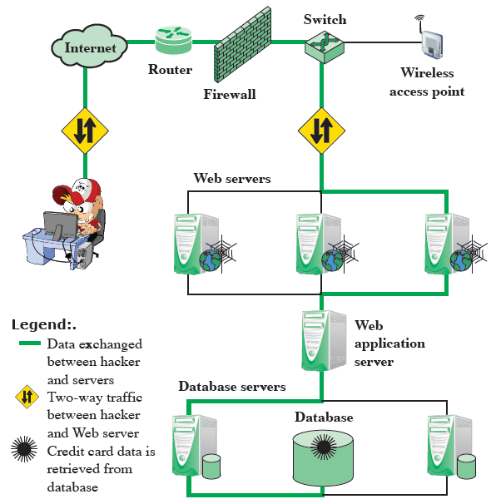
A typical injection attack

Slide 14
Sample SQL injection
The SQLi attack typically works by prematurely terminating a text string and appending a new command
SELECT fname
FROM student
where fname is ‘user prompt’;
User: John’; DROP table Course;--

Slide 15
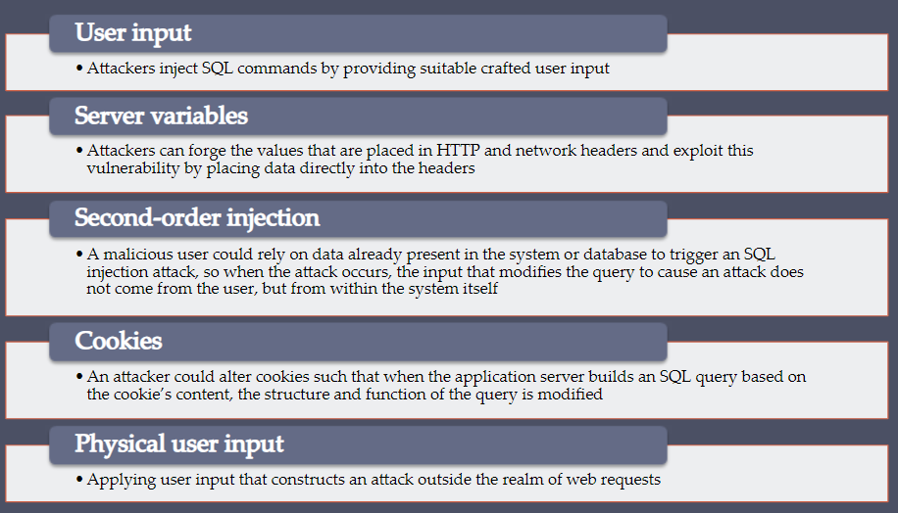
Avenues of Attack
User Input (HTTP GET & POST)
Server Variables
Second Order Injection
Cookies
Physical user input

Slide 17
In-band attacks
Tautology: This form of attack injects code in one or more conditional statements so that they always evaluate to true
End-of-line comment: After injecting code into a particular field, legitimate code that follows are nullified through usage of end of line comments
Piggybacked queries: The attacker adds additional queries beyond the intended query, piggy-backing the attack on top of a legitimate request

Slide 18
Sample SQL injection: tautology
$query= “
SELECT info FROM user WHERE name =
`$_GET[“name”]’ AND pwd = `GET[“pwd”]`
”;
Attacker enters: ` OR 1=1 –-

Slide 19
Sample SQL injection: Piggybacked
User Send:
“SELECT * FROM <table>”
  and somebody who might have guessed the name of this table
Server process:
SELECT * FROM customers; TRUNCATE TABLE customers;

Slide 20
Inferential Attacks
No actual transfer of data.
Attacker is able to reconstruct the information.
He sends particular request and observes the behavior.

Slide 21
Inferential Attacks
Illegal / logically incorrect queries: In this type of injection an attacker is trying gather information about the type and structure of the back-end database of a Web application.
Blind SQl Injection: The attacker ask the server true/false questions.
http://newspaper.com/items.php?id=2
SELECT title, description, body FROM items WHERE ID = 2
http://newspaper.com/items.php?id=2 and 1=2

Slide 22
Out-band attack
Data retrieval using other channel.

Slide 23
SQLi countermeasures
Defensive coding: stronger data validation
Detection
  Signature based
  Anomaly based
  Code analysis
Runtime prevention: Check queries at runtime to see if they conform to a model of expected queries

Slide 24
Database Access Control
DBMS provide access control for database
assume have authenticated user
DBMS provides specific access rights to portions of the database
  e.g. create, insert, delete, update, read, write
  to entire database, tables, selected rows or columns
  possibly dependent on contents of a table entry
can support a range of policies:
  centralized administration
  ownership-based administration
  decentralized administration

Slide 25
SQL Access Controls
If the user has access to the entire database or just portions of it
Two commands:
  GRANT {privileges | role} [ON table] TO {user | role | PUBLIC} [IDENTIFIED BY password] [WITH GRANT OPTION]
    e.g. GRANT SELECT ON ANY TABLE TO john
  REVOKE {privileges | role} [ON table] FROM {user | role | PUBLIC}
    e.g. REVOKE SELECT ON ANY TABLE FROM john
  WITH GRANT OPTION: whether grantee can grant “GRANT” option to other users
Typical access rights are:
  SELECT, INSERT, UPDATE, DELETE, REFERENCES

Slide 26
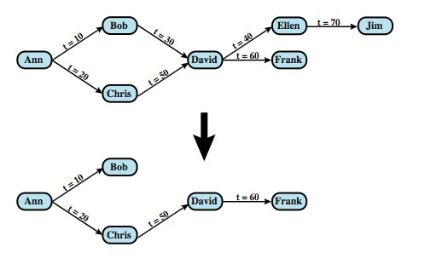
Cascading Authorizations

Slide 27
Role-Based Access Control
Role-based access control work well for DBMS
  eases admin burden, improves security
Categories of database users:
  application owner
  end user
  administrator
DB RBAC must manage roles and their users

Slide 28
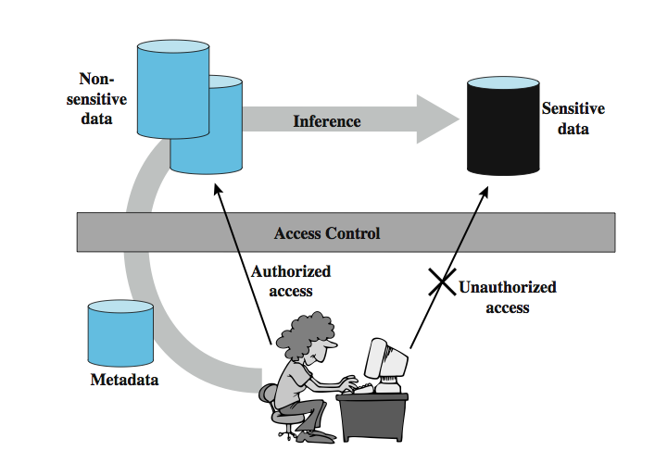
Inference

Slide 29
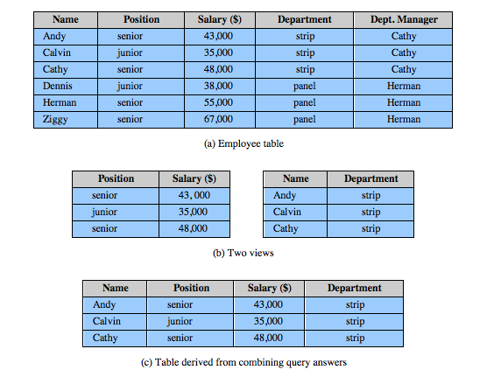
Inference Example

Slide 30
Inference Countermeasures
Inference detection at database design
  alter database structure or access controls
Inference detection at query time
  by monitoring and altering or rejecting queries

Slide 31
Statistical Databases
Provides data of a statistical nature
  e.g. counts, averages
Two types:
  pure statistical database
  ordinary database with statistical access
    some users have normal access, others statistical
Access control objective to allow statistical use without revealing individual entries
Security problem is one of inference

Slide 32
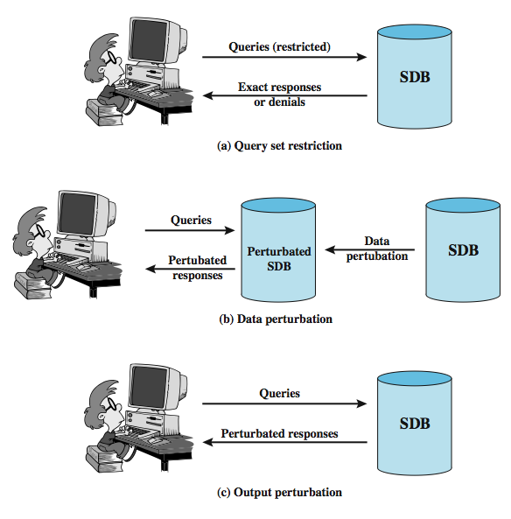
Protecting Against Inference

Slide 33
Perturbation
Add noise to statistics generated from data
  will result in differences in statistics
Data perturbation techniques
  data swapping
  generate statistics from probability distribution
Output perturbation techniques
  random-sample query
  statistic adjustment
Must minimize loss of accuracy in results

Slide 34
Database Encryption
Databases typical a valuable info resource
  protected by multiple layers of security: firewalls, authentication, O/S access control systems, DB access control systems, and database encryption
Can encrypt
  entire database - very inflexible and inefficient
  individual fields - simple but inflexible
  records (rows) or columns (attributes) - best
    also need attribute indexes to help data retrieval
Varying trade-offs

Slide 35
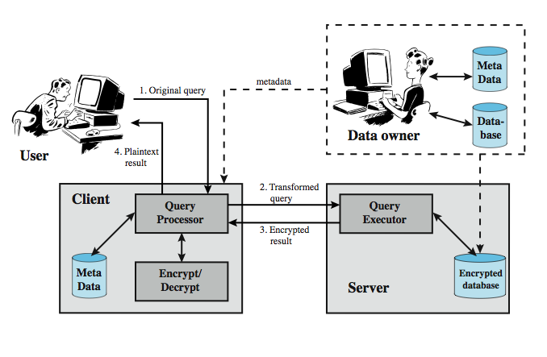
Database Encryption

